Slide 1

Topic 4 (Pt 1): Morphology, Words & Transducers

Slide 2
Morphology
Morphology is the study of the way words are built up from smaller meaning bearing units, known as morphemes
Morpheme is the smallest meaningful unit of a word
Example :
hat consists of a single morpheme
hat
ants consists of two morphemes :
ant + -s

Slide 3
Morphemes
Adds meaning to a word, can be further divided into prefixes, suffixes, infixes, and circumfixes
Prefix: precedes the stem/root word
e.g: en - able
Suffix : follows the stem/root word
e.g: buy - ing
Circumfix : surrounds a stem/root word
e.g: en - ligten - en
Infix : inserted in between a stem/root word
e.g: t - el - unjuk (e.g: “tunjuk” or point - Malay)

Slide 4
Types of Morphology
Concatenative
Words are composed of a number of morphemes concatenated together, usually in sequence (e.g: computerization)
Prefixes and suffixes are considered concatenative
Non-concatenative
Words are composed or combined in more complex ways, usually not in sequence
Infixes and circumfixes are considered non-concatenative

Slide 5
Concatenative Morphology
Assumption: Complex words are created through dynamic processes; these processes operate on a specified input and produce a specified output
Prefixes and suffixes are often called concatenative morphology since a word is composed of a number of morphemes concatenated together.
Concatenation may also involve compounding, a morphological process that concatenates two roots or two stems.
Example:
houseboat (e.g., English: house + boat)
kakitangan (e.g., Malay: kaki + tangan)

Slide 6
Non-concatenative Morphology
Some languages have extensive non-concatenative morphology, in which morphemes are combined in more complex ways.
The Tagalog (lang. of the Phillippines) infixation is one example of non-concatenative morphology, since two morphemes (hingi and um) are intermingled to form humingi.
Another kind of non-concatenative morphology is called templatic morphology or root-and-pattern morphology (e.g., Arabic)

Slide 7
Non-concatenative Morphology
Example 1: Tagalog (Philippines) infixation
Two morphemes (hingi and um) are intermingled to form humingi.
h u m i n g i
Example 2: Arabic templatic/root-pattern morphology (e..g., ktb is the root pattern)
k i t a b i k u t u b
ب ت ك
ب ت ك

Slide 8
Morphological Parsing
Parsing means taking an input and producing some sort of structure for it
Example: Recognizing that the word foxes breaks down into the two morphemes fox and -es is called morphological parsing
In information retrieval, the problem of mapping between foxes to fox is known as stemming
In morphological parsing, given the surface or input form going, we might want to produce the parsed form VERB-go + GERUND-ing.

Slide 9
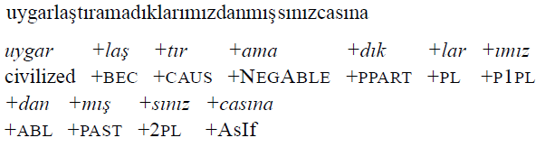
Morphological Rules
Morphological rules need to be encoded in order to successfully perform morphological parsing
Not all morphological variants of every word in morphologically complex languages like Turkish can be listed:
Meaning: “(behaving) as if you are among those whom we could not civilize/cause to become civilized”
In such languages we clearly need to parse the input since it is impossible to store every possible word

Slide 10

Inflectional Morphology (English)
English has a relatively simple inflectional system; only nouns, verbs, and sometimes adjectives can be inflected, and the number of possible inflectional affixes is relatively small
English nouns has two kinds of inflection:
An affix that marks plural
An affix that marks possessive (e.g., children’s, buses’)

Slide 11
Inflectional Morphology (cont…)
English verbal inflection is more complicated than nominal (noun) inflection because English has 3 kinds of verbs:
main (e.g., eat, sleep, drink)
modal (e.g., can, will, should)
primary (e.g., be, have, do)
English verbs are considered regular when all verbs of the same class have similar endings marking the same functions
English verbs are considered irregular when verbs of the same class may have multiple forms of inflections

Slide 12
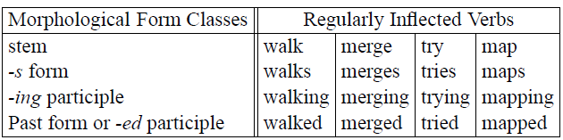
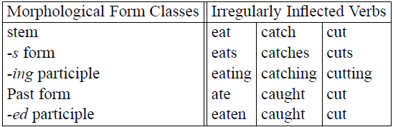
Inflectional Morphology (cont…)
Regular vs irregular verbs

Slide 13
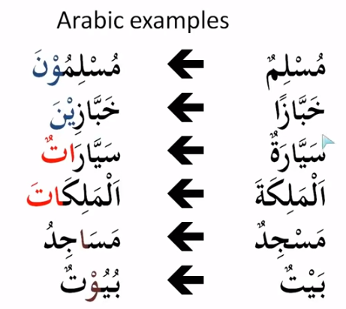
Inflectional Morphology (Arabic)
Regular vs irregular nouns
Muslimuuna (Muslims)
Muslim
habbazina (bakers)
habbaz
regular
sayyaratun (cars)
sayyarah
al-malikaat (queens)
al-malikah
masaajidu (mosques)
masjid
irregular
buyut (houses)
bait

Slide 14
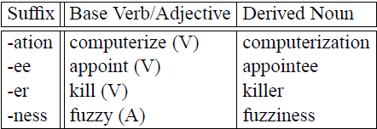
Derivational Morphology (English)
Derivation is a combination of a word stem with a grammatical morpheme/affix, resulting in a different word class with a meaning hard to predict
A common kind of derivation in English forms new nouns, usually from verbs or adjectives, a process known as nominalization
New word class

Slide 15
Derivational Morphology (Malay)
Derivation is a combination of a word root with a grammatical morpheme/affix, resulting in not necessarily a different word class with a meaning hard to predict
Affix | Base | Derivation
beR- (prefix) | lari (V) | berlari (V)
-an (suffix) | main (V) | mainan (N)
ke - X - an (circumfix) | besar (ADJ) | kebesaran (N)
pe - X - an (circumfix) | rumah (N) | perumahan (N)
mem-peR- X - kan (circumfix) | kecil (ADJ) | memperkecilkan (V)
em (infix) | jari (noun) | jemari (N)

Slide 16
Finite State Transducers (FST)
A transducer maps between one set of symbols to another. A finite-state transducer does this via a finite automaton, commonly visualized as a two-tape automaton which recognizes or generates pairs of strings.
The FST has a more general function than an FSA. An FSA defines a formal language by defining a set of strings while an FST defines a relation between sets of strings.
This relates to the view of FST as a machine that reads one string and generates another

Slide 17
Finite State Transducers (FST)
Uses a directed graph to encode a mapping from a set of I{input strings} to a set of O{output strings}.
An I{input string} is a sequence of immutable values (such as integers, characters, or strings) called S{input symbols}.
An O{output string} is a sequence of immutable values called X{output symbols}. Collectively, input strings and output strings are called Y{symbol strings}, or simply Y{strings} for short.
Note that this notion of Y{string} is different from the python string type -- symbol strings are always encoded as tuples of input or output symbols, even if those symbols are characters.
An empty sequence (ϵ) is a valid symbol string.

Slide 18
FST as recognizers
FST as recognizer : A transducer that takes a pair of strings as input and outputs and accept if the string-pair is in the string-pair language, and reject if it is not.
FST as generator: A machine that outputs pairs of strings of the language. Thus the output is a yes or no, and a pair of output strings.
FST as translator: a machine that reads a string and outputs another string.
FST as set relater: a machine that computes relations between sets.

Slide 19
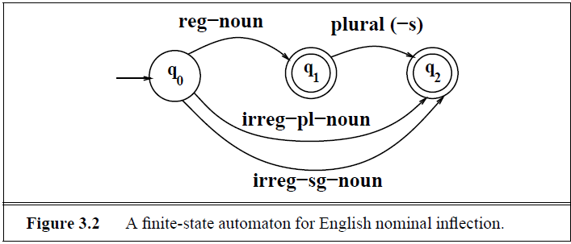
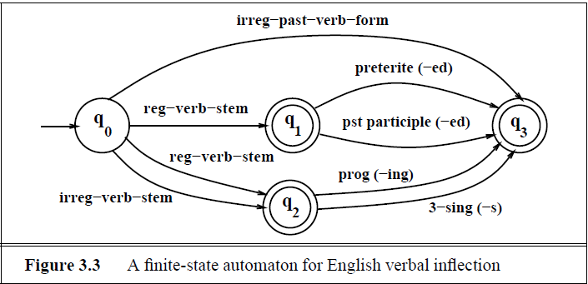
FSA for English

Slide 20
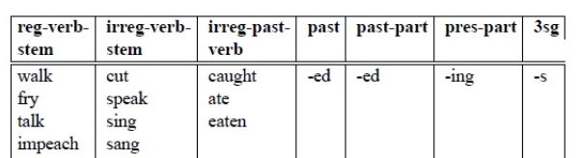
FSA for English

Slide 21
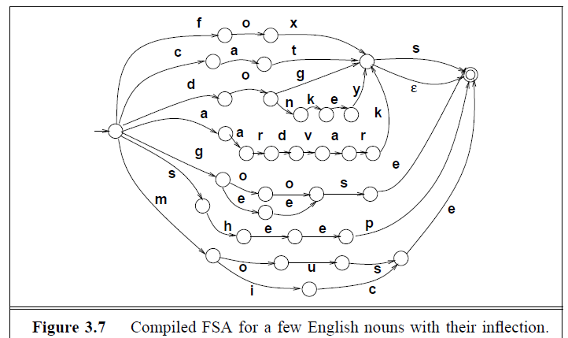
FSA for English

Slide 22
FSA vs FST for English
An FSA accepts a language stated over a finite state of symbols, as in our “sheep language” example:
∑ = {b, a , !}
An FST accepts a language stated over pairs of symbols:
∑ = {a:a, b:b ,!:!, a:!, a:ϵ , ϵ:!}

Slide 23
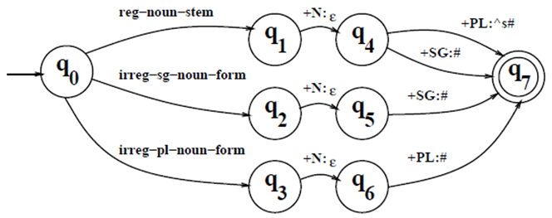
Finite State Transducers for English
States : Q = {q_{0,} q_{1,} q_{2,} q_{3,} q_{4,} q_{5,} q_{6,} q₇}
Initial state: S = {q₀}
Final state/s : F = {q₇}

Slide 24
Morphological Parsing and FST
Finite State Transducers can be used to represent lexicon (a repository of words) and perform morphological recognition.
Given the input cats, we wish to output the features of the morphological features of the word cat as cat + N + PL to indicate that cat is a noun of plural form.
This can be done using a two-level morphology (Kokenniemi, 1983)
Morphological information (i.e, morphological features) +N +PL which tells us that cats is a plural noun.

Slide 25
Morphological Parsing (cont…)
Two level morphology represents a word as a correspondence between:
a lexical level, which represents a simple concatenation of morphemes making up a word,
the surface level, which represents the actual spelling of the final word.
Morphological parsing is implemented by building mapping rules that map letter sequences like cats on the surface level into morpheme and features sequences like cat +N +PL on the lexical level.

Slide 26
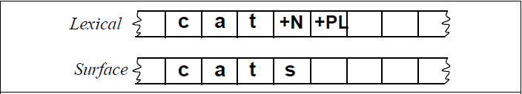
Morphological Parsing with FST
Automaton used to map between the two levels is known as Finite State Transducers
The lexical level has a stem for a word, followed by the morphological information which tells that cats is a plural noun
Example of lexical and surface tapes

Slide 27
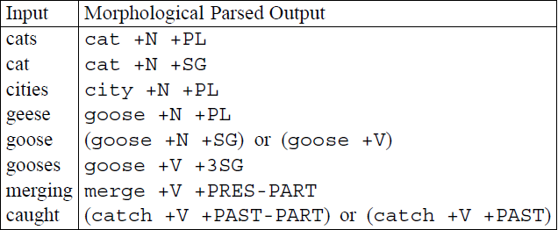
Finite State Morphological Parsing
Goal: Takes input forms (as in Col 1) and produce output forms (as in Col 2)
The second column contains the stem of each word (e.g., ‘cat’) as well as its morphological features (e.g., N (Noun) + PL (Plural) )

Slide 28
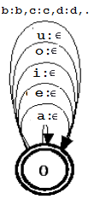
Using FST to map a language: Python Example
Devowelizer (devowelizer.py)
Inherit from the FST class in nltk_contrib.fst package
Input random words made up of ASCII letters
Output/print an empty string (ϵ) if a vowel is seen, else print the original letter
Use only 1 single state, both as the initial and final state
Add arcs/paths for transitions of ASCII letters

Slide 29
Using FST to map a language: FST Exercise
Create an FST that uses 2 states:
State 1 - initial, final
State 2 – final
State 3 - final
Read an input string
If a vowel character is found, print 'V'
If a consonant character is found, print 'C‘
If other than vowel or consonant (e.g: special symbol), print ‘I’
(Hint: Think about how to jump from one state to another if the string is a combination of both vowels, consonants and/or special characters(e.g.: CVCVIVC), OR if there is a repeating sequence or consonants in the string (e.g.: VV or CC or II))

